Slide 1


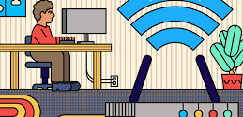

CNS PROJECT
TEAM MEMBERS:​
S.J SUMANTH(2010030377)​
K. SREEVARUN(200030451)​
E. PAVAN SAI(2010030538)​
E. SHIVA GOUD(2010030542)​

Slide 2
Outline:
Project-1:
Abstract
Introduction
Literature review
Methods
Results
Conclusion

Slide 3


IPSEC BASED Virtual private network FOR A COMPANY

Slide 4

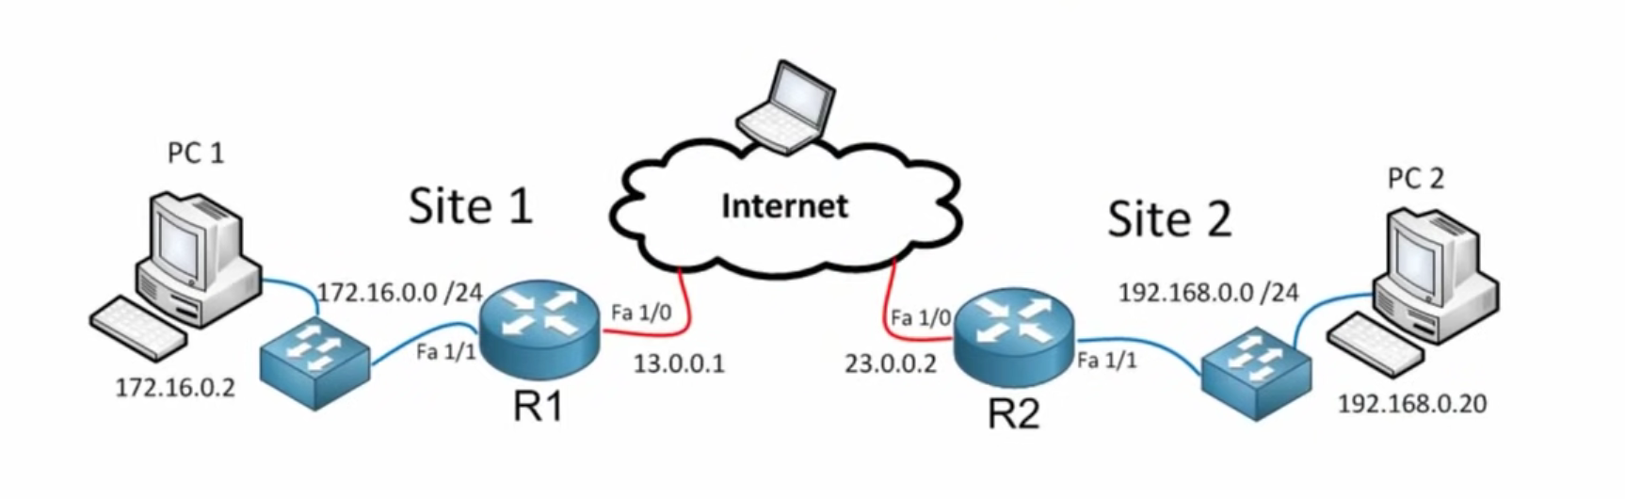
Abstract
Nowadays, organization do all they can to maintain control and help protect their corporate networks and its information asset from cyber threats. However, they heavily rely on the users as the first line of defense who sometimes are not compliance to network security regulations enacted. Therefore, it is vital for the company to ensure cybersecurity awareness and possibly security implications that can emanate from cyberattacks such as malware and network intrusions.
In addition to existing policy and network security mechanism and services, an IPsec VPN has been proposed as one of the most fundamental data security practices to ensure data privacy and protect systems effectively.
IPsec VPN authenticates and encrypt the virtual connections between two nodes. The use of IPsec protocols to implement VPN can help to protect against system vulnerabilities such as IP spoofing, session hijacking, traffic sniffing. Therefore, implementing security controls to provide confidentiality, integrity and availability.

Slide 5

Introduction:
A virtual private network (VPN) gives you online privacy and anonymity by creating a private network from a public internet connection.
VPNs mask your internet protocol (IP) address so your online actions are virtually untraceable. Most important, VPN services establish secure and encrypted connections to provide greater privacy than even a secured Wi-Fi hotspot.
VPN is widely used since it provides secure transmission of data packets at the IP layer using authentication and encryption

Slide 6

Literature Review
Some papers and publications argue very simply that VPN does not explicitly incur overhead processing on the network, but that the Internet influences efficiency. According to an article that VPN Consultants reported in the San Francisco Bay Area on security FAQ, the bulk of slowdowns in efficiency were in fact triggered by incoherent internet links rather than overhead encryption processing.
Liu, L, also, says. And Gao, W. And Gao. (2007), clarified that IPv4 (a commonly used Internet protocol) networks have inherent vulnerabilities that are now barriers to network growth. They contend that network implemented VPNs, i.e. the internet itself automatically inherits some other issues such as high network overheads, lack of service quality assurance (QoS), the NAT-crossing problem, etc. They propose to address this problem effectively with VPNs that are implemented on the version 6 (IPv6 Internet Protocol), known as Next generation protocol.“ Often a VPN tunnel can be impacted by high packet loss and packet rearrangements. Any bridged protocols can have issues with rearranging.

Slide 7

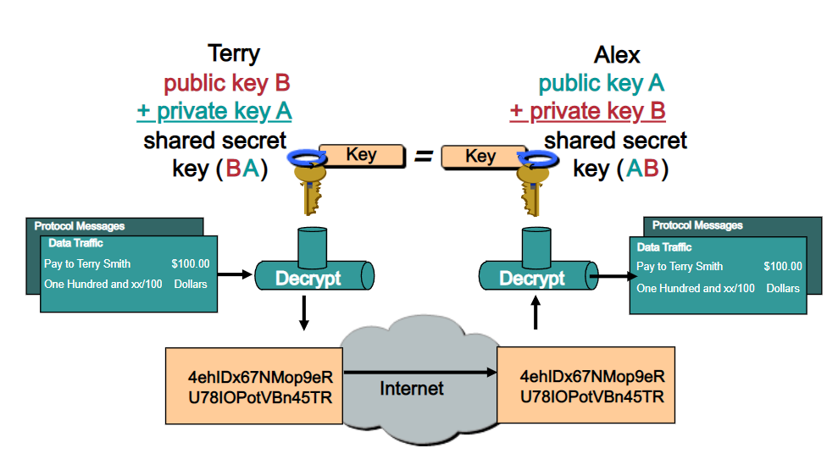
Methods
We are using cisco packet tracer for Implementing this project.
The IPsec VPN configuration will be in four phases.
1.Configure RSA(Rivest-Shamir-Adleman encryption)
Keys
2. Prepare for IPSec, IKE and configure IKE(Internet
Key Exchange)
3. Configure IPSec
4. Test and Verify IPSec

Slide 8

Conclusion
A virtual private network (VPN) is an encrypted connection between two or more computers. VPN connections take place over public networks, but the data exchanged over the VPN is still private because it is encrypted. VPNs make it possible to securely access and exchange confidential data over shared network infrastructure, such as the public Internet. For instance, when employees are working remotely instead of in the office, they often use VPNs to access corporate files and applications. Many VPNs use the IPsec protocol suite to establish and run these encrypted connections.

Slide 9


